Slide 1
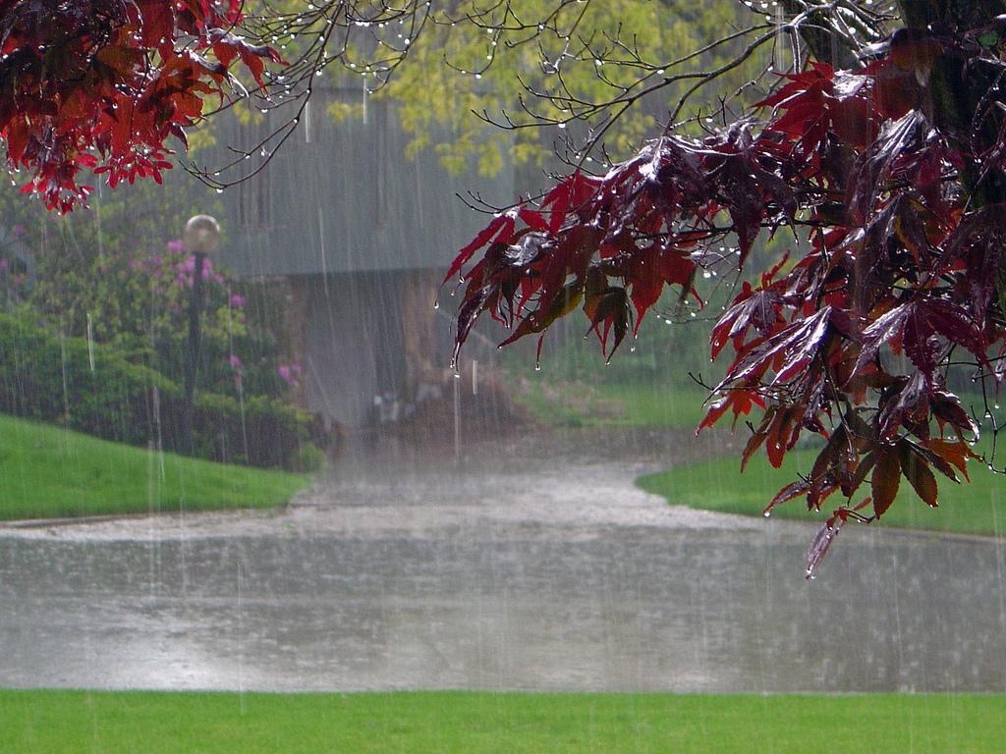
What is a Watershed ?
Notes:
What is a watershed? What do we see happening in the picture? Note the rain water dripping off the leaves and explain that the leaves are “shedding” the water. Is this what we mean is happening in a watershed? Note the difference between the pavement and the grassy areas. Water will either run off or soak in (infiltrate).

Slide 2
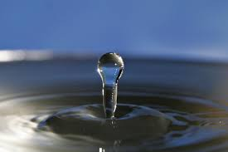
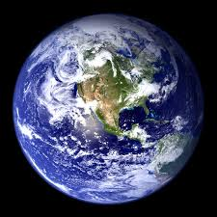
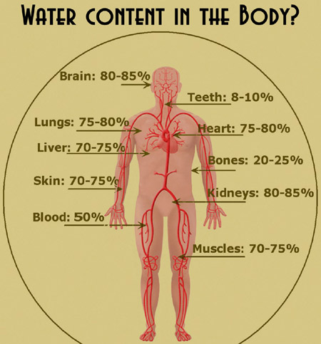
How Important is Water?
The surface of planet Earth is covered by about 70% water.
The Human Body is about 65% water (on average).
Notes:
Explain that only a very small portion of the water on Earth is available for us to use as fresh water. The vast majority is either sea water or frozen in the ice caps and glaciers. These averages for the human body are by WEIGHT. Different parts of the body have more water than others.

Slide 3
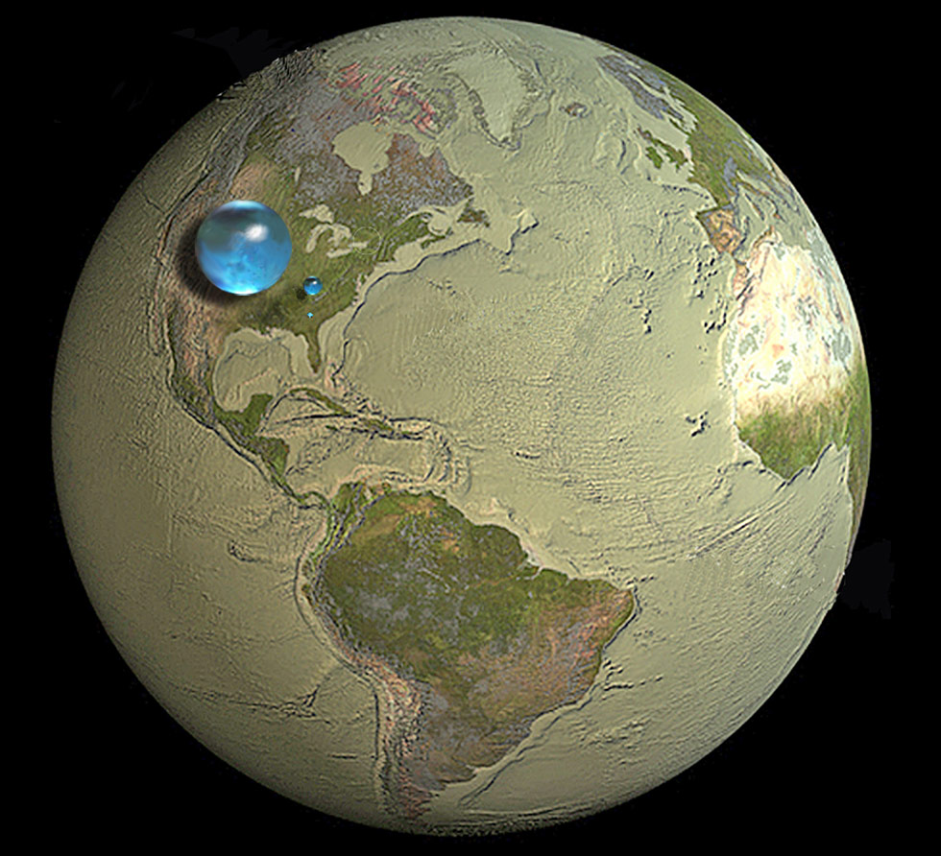
Notes:
Large sphere (860 miles in diameter) represents all water on Earth.
Small sphere (169 miles in diameter) represents the fresh water in the ground and above in lakes, rivers, swamps, etc.
Tiny dot (34.9 miles diam.) represents just fresh water in lakes and rivers.

Slide 4
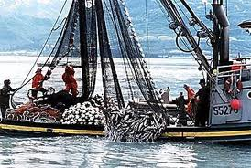
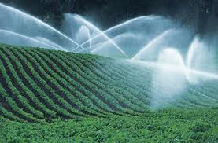
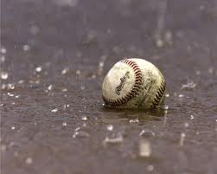
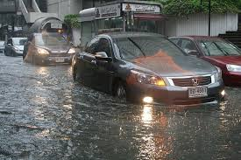
Water Impacts Our Lives Everyday
Notes:
Water provides us with food from the oceans and fresh water bodies in the form of fish. It is needed for plants and animals to grow on land. It affects our daily activities and can even be a source of danger when there’s too much of it at one time.

Slide 5

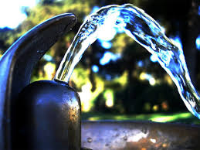
Where does water come from?
Notes:
For many young students the first thought is that water comes from a fountain or a faucet. Trace the path of water from the faucet or water fountain back to the water treatment plant and then back to the body of water that is drawn from.

Slide 6
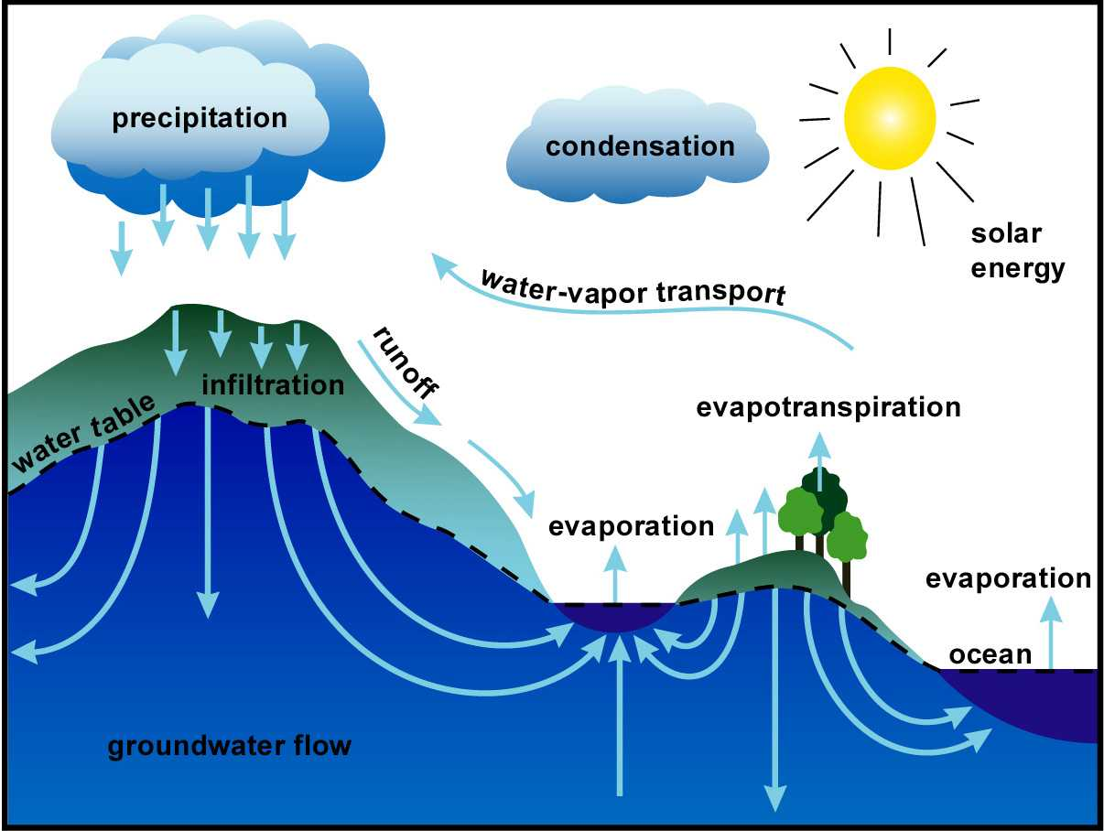
The Water Cycle
Notes:
New water is not being made. We have all the water on Earth that we will ever have. Fortunately, it gets cleaned and renewed through the water cycle. Every time that water evaporates from the surface of the Earth it is purified by leaving behind any material that is dissolved or suspended in it. Let’s highlight this part of the cycle called precipitation and look at what happens to the water when it falls from the sky.

Slide 7
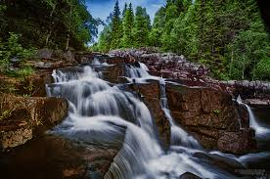
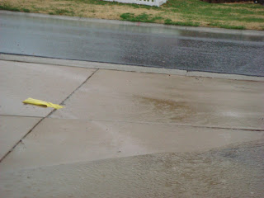
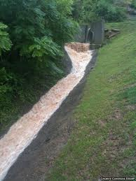
Where does the rainwater go?
Downhill
Notes:
Accept all responses. Storm sewer – rainwater is routed directly to creeks – not to treatment plant.
Sanitary Sewer – waste water (toilet, sinks, showers etc.) – goes to treatment plant.
The two should not intersect, but at times (heavy rainfall), they do. Raw sewage can pour onto streets and directly into streams or overflow the treatment plant to the same end.

Slide 8
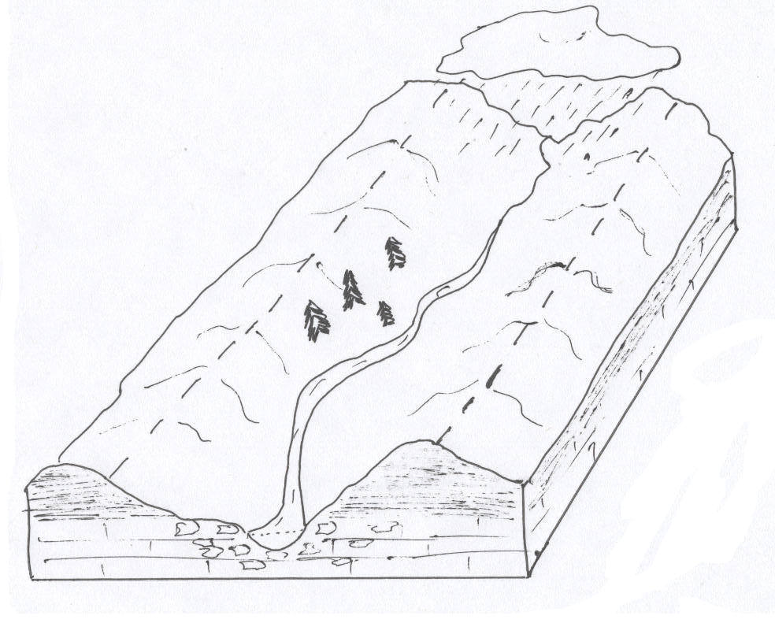
Watershed
Watershed Divide
2
3
1
Watershed divide: Ridges that separate two watersheds
Watershed : All of the land that drains water into one place
How many watersheds are pictured?
3
Notes:
What is a watershed? Since gravity forces water to always flow downhill the boundaries of a watershed are determined by the highest elevations in the area. Hill tops are called divides. Watershed is the land that drains water into one place. Two divides are shown. Two divides separate three watersheds.

Slide 9
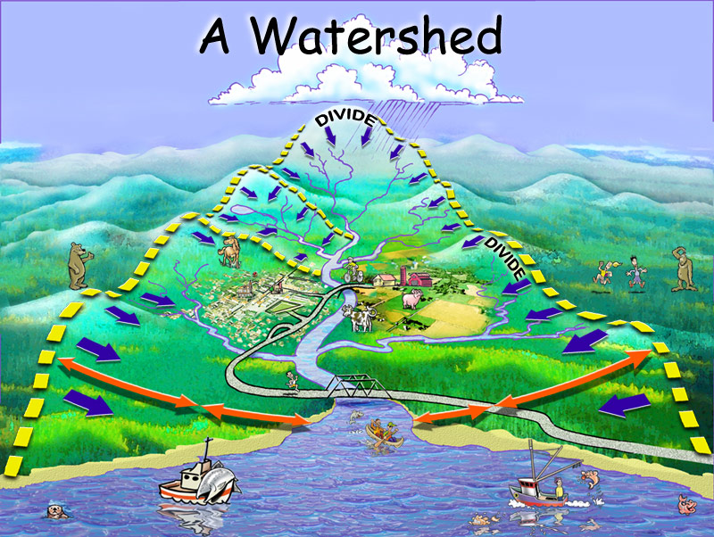
The land that drains water into a stream, river or lake. It can be small or extremely large.
Notes:
Simplest definition of the term. Note that the boundary of the watershed is formed by a divide. The divide is formed by hills and ridges. In many places the divide is difficult to see because the elevation difference is very slight. Point out some of the varied activities taking place within the watershed and ask what effect these activities might have on the quality or health of the water.

Slide 10
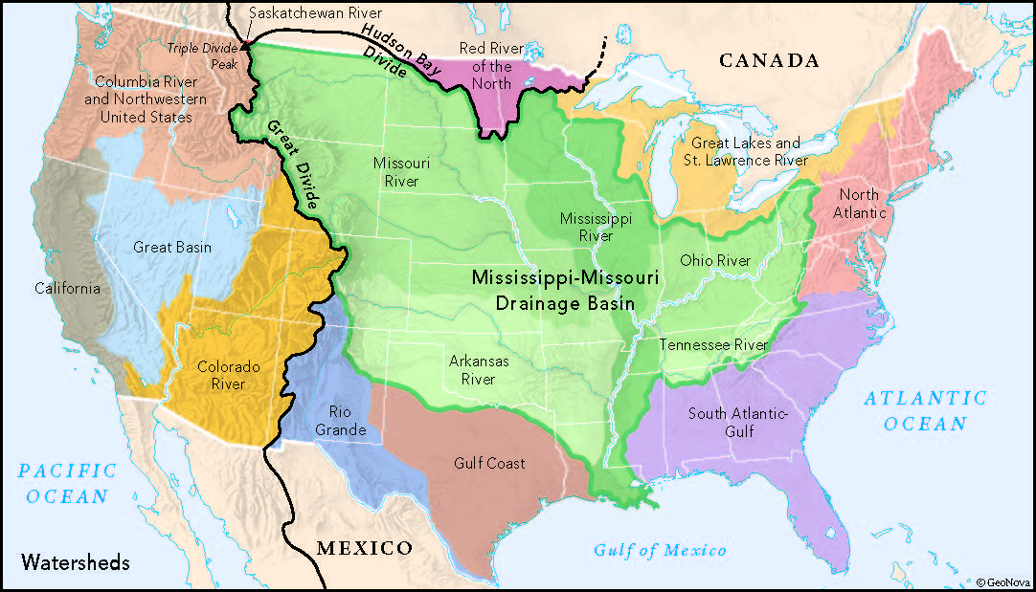
Notes:
The very large watersheds are commonly referred to as river basins. The largest are shown on this map with the major divides that delineate them.

Slide 11
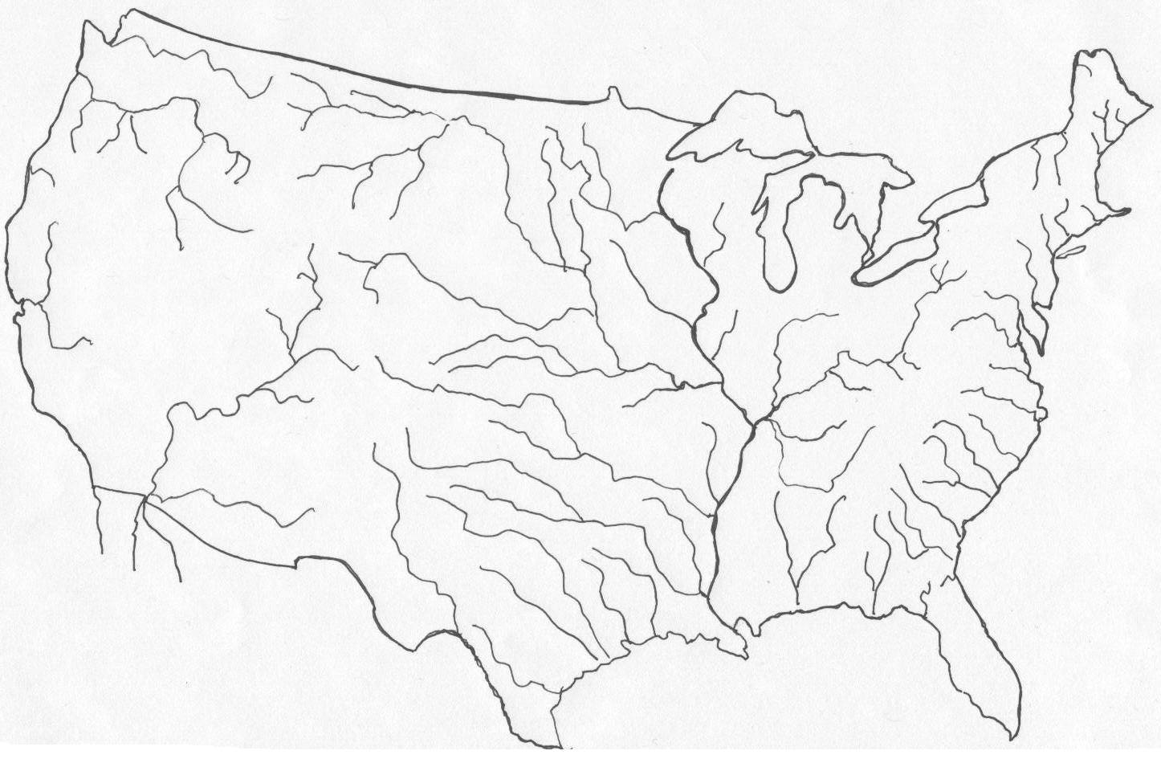

What is the largest watershed (basin) in North America?
In what “subwatershed” of the Mississippi will you find most of Kentucky’s land area?
Pacific
Atlantic
Mississippi River Basin (Watershed)
Ohio River Basin (Watershed)
Gulf of Mexico
Notes:
Mississippi River Basin – blue
Ohio River Basin – red
Keep track of Kentucky (house button)
most of the state is in the Ohio River Basin (weather reports talk of the Ohio River Valley – same thing)

Slide 12
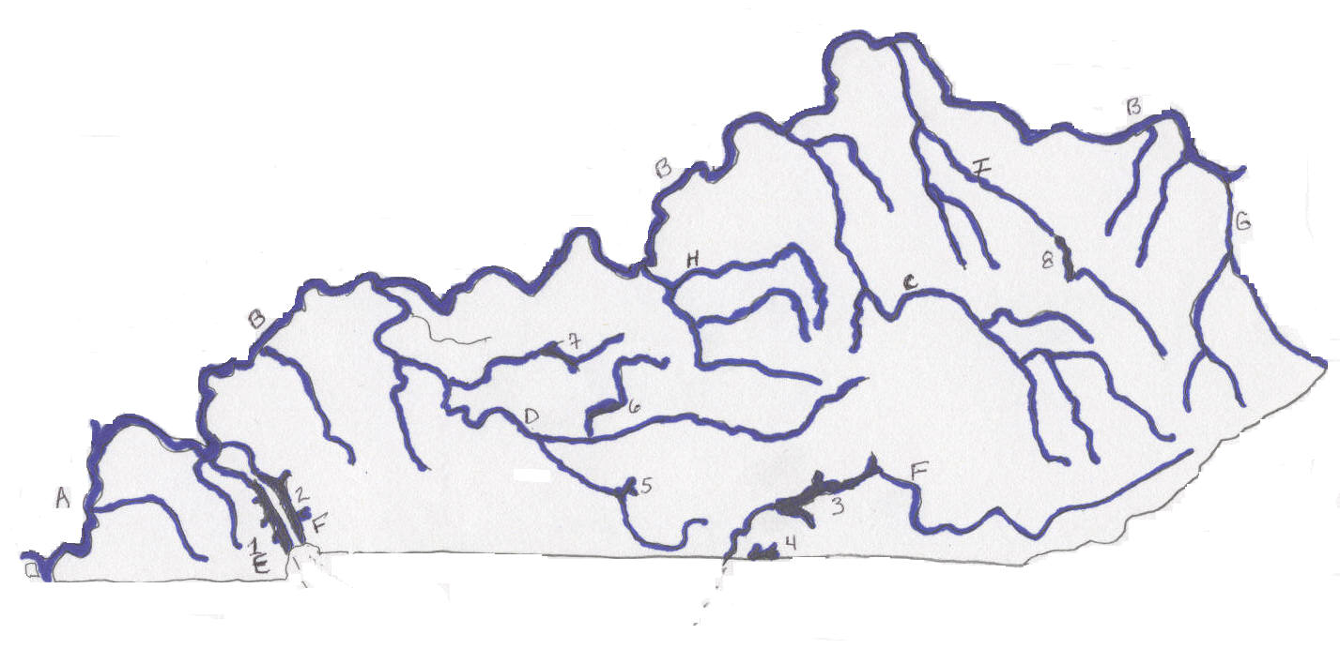
Kentucky Watersheds
Lakes
1) Kentucky 2) Barkley
3) Cumberland 4) Dale Hollow
5) Barren River 6) Nolin River
7) Rough River 8) Cave Run
B
B
I
G
H
C
8
B
7
D
6
F
A
2
5
1
F
3
E
4
Rivers
A) Mississippi
B) Ohio
C) Kentucky
D) Green
E) Tennessee
F) Cumberland
G) Big Sandy
H) Salt
I) Licking
Notes:
All KY lakes are manmade (except for a few small ones in far western KY) – a dam was built on a river to impound the water – usually for flood control, hydroelectric (1 and 2), recreation
Have students try to name the river before clicking to reveal each name. Keep track of specific location too.
Note: Salt and Licking rivers get their names from the many salt licks used by animal herds and pioneers to get their salt. Largest salt manufacturing site east of the Appalachians in late 1700’s was in what is now Bullitt Co. on the Salt River.
Note: Cumberland source is in mountains of E. KY, flows south into TN and then west and north back into KY – forms Lake Barkley
Tennessee River forms Kentucky Lake in western KY

Slide 13
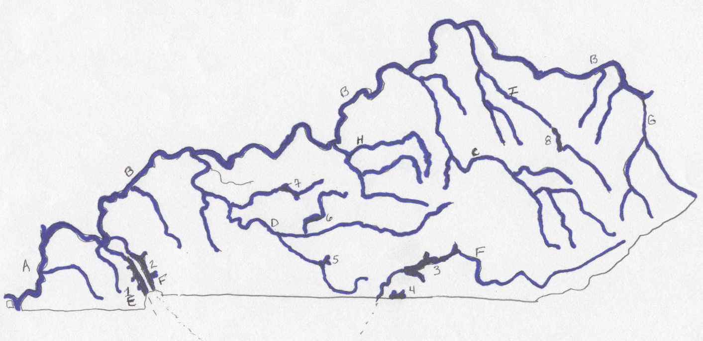
Watersheds of the Kentucky and Green Rivers
By starting at the river mouth and drawing a line to separate two rivers from each other, the approximate watershed for that river can be drawn.
Notes:
Separating the rivers gives the approximate watershed or basin for each river. Note the next slide for more formal results.
Can choose any river to do.

Slide 14
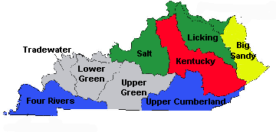
River Basins of Kentucky
Notes:
Major watersheds of Kentucky. Along the Ohio River there should be Ohio River watershed areas (see the green areas above the Licking River watershed for example).

Slide 15
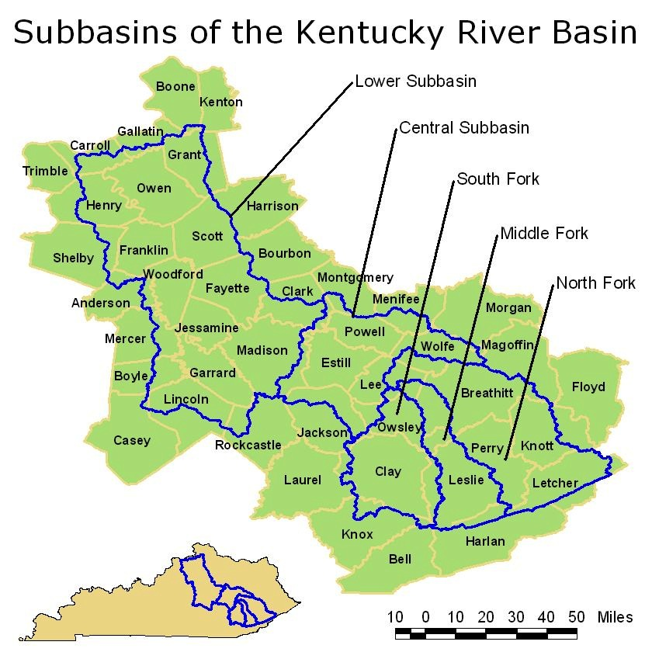

Slide 16
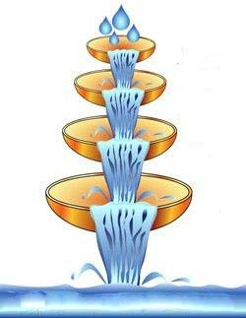
Large drainage areas can be broken down into smaller ones that “nest” inside them.
Sub-watersheds
Notes:
As water flows from a tributary to a larger stream, the various sized watersheds are connected. Largest scale is the ocean.

Slide 17
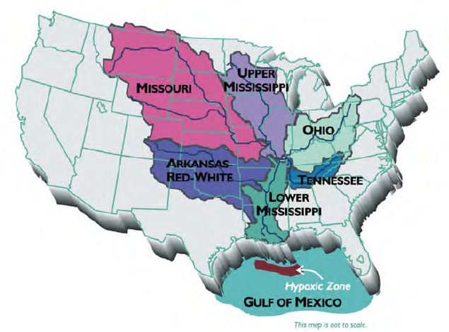
Hypoxic Zone
Hypo = under, low
Oxic = Oxygen
Area where very low level of dissolved oxygen prevents the existence of living things.
Caused by a process called Eutrophication

Slide 18
Cultural Eutrophication
Use of fertilizers and other phosphates in watershed
Runoff to rivers
Excessive algae growth
Decomposition of dead algae by aerobic bacteria
Depletion of dissolved oxygen
Dead Zone forms
Hypoxic Zone Resources:
http://www.gulfhypoxia.net/
http://www.ncddc.noaa.gov/hypoxia/
Notes:
Summary of Cultural Eutrophication

